Slide 1
Secrets management with Hashicorp Vault

Slide 2
Focus
What is secrets management
Why do we need it
What is Hashicorp Vault and how can it help you secure your infra/processes
Vault features and possible use cases

Slide 3
Goal
Raise awareness regarding security best practices
Think about your approach to secrets management in your project
Inspect and adapt your security design
Go and play with Hashicorp Vault (or any other tool / process)

Slide 4
Secrets management 101
“Secrets management refers to the tools and methods for managing digital authentication credentials (secrets), including passwords, keys, APIs, and tokens for use in applications, services, privileged accounts and other sensitive parts of the IT ecosystem.”

Slide 5
Common misconceptions
”We only have 2 or 3 credentials, it’s not worth the trouble”
“Hashicorp Vault is difficult to deploy and manage”
Easy deployment – Service / Container / Kubernetes / Cloud Managed Solution
Easy update – Single binary
Built for high avilability – Raft storage backend / Consul / etc
Easy maintenance – Backups / restore with a single command (High availability) or a disk snapshot (standalone)
“I do not need auditing”
Keepass is secure / Git is secure

Slide 6
Secrets management 101
Don’t let your authentication secrets live forever
Distribute auth secrets securely
Limit exposure if auth secrets are disclosed
Have a break-glass procedure in case of auth secrets are stolen/exposed
Detect unauthorized access to auth secrets
> Limit of uses, short ttl
> Vault with HTTPS / leveradge already implemented infra ( Jenkins / Orchestrator / etc )
> Use principle of least priviledge in your roles
> Use audit logs and revoke API
> APP should alert if secret is absent/no good

Slide 7

Who am I and why talk about this
Carlos Cunha
Past :
Windows Sysadmin and Ops guy for more than 20 years
Present :
DevOps Engineer in the CTW ITOps Team
Team Goal
Advertise best practices and tooling for development teams @ CTW

Slide 8

Why Hashicorp Vault
Unmatch feature set
Open Source
mostly !! Some closed source features aimed for specific scenarios
Multi-Datacenter replication, 2FA, FIPS compliance, etc.
Not vendor or framework specific
Single binary
Enterprise support is available if this is a requirement

Slide 9
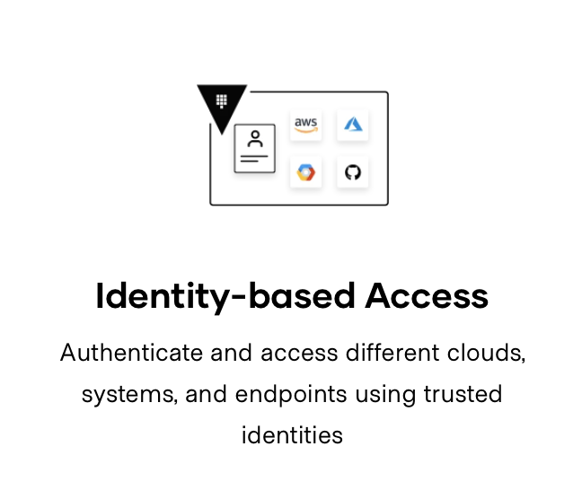
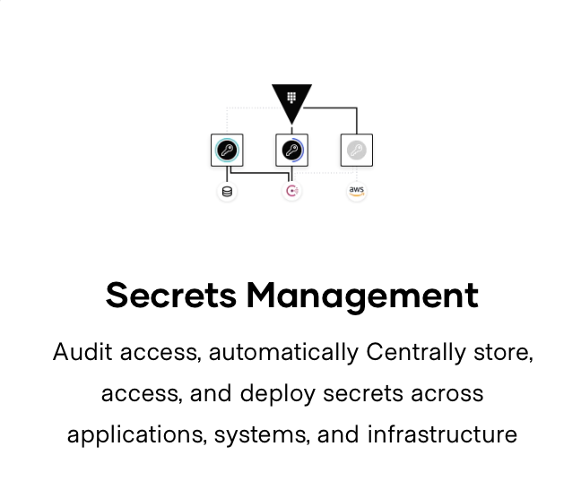
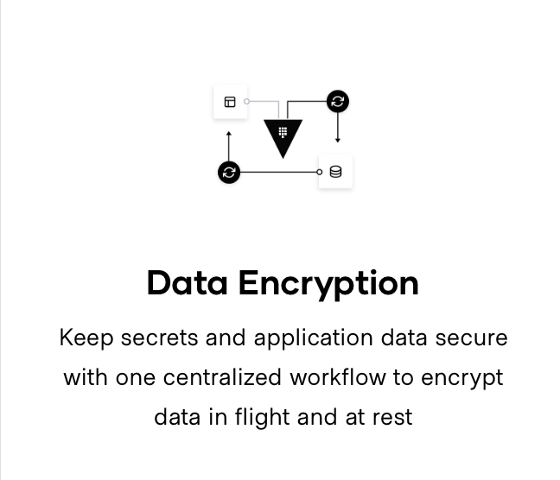
Vault
Auth-n + Auth-z
(Authentication + Authorization)

Slide 10
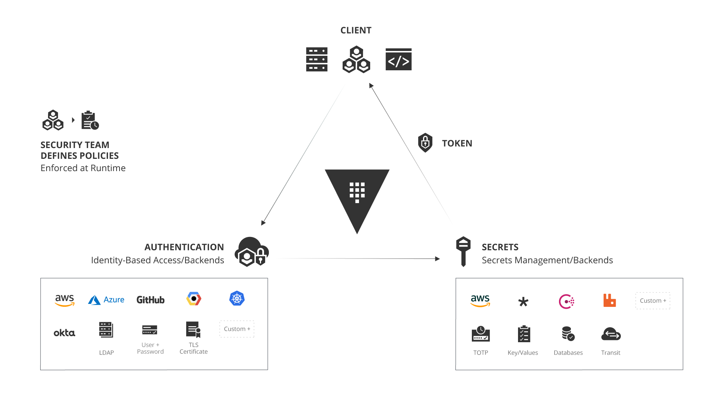
Vault

Slide 11
Vault
Secures, Stores and tightly controls:
Tokens
Passwords
API Keys
Other secrets
Handles:
Leasing
Key revocation
Key rolling
Certificates
Auditing
All vault functions are build around its API

Slide 12
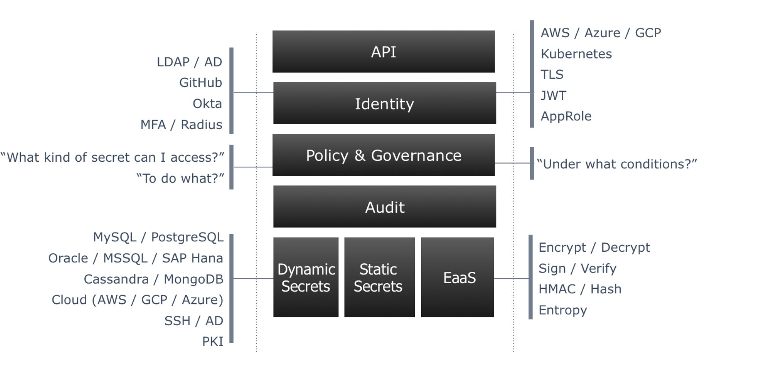
Vault

Slide 13
Vault
Authentication Backends
Token | GitHub
AliCloud | OCI
Cloud Foundry | Okta
AWS | Tokens
Oracle Cloud Infrastructure | RADIUS
Google Cloud | TLS Certificates
Azure | Username & Password
LDAP | AppRole
JWT / OIDC | Kerberos
Kubernetes

Slide 14
Vault
Authorization Engines
Active Directory | AWS
AliCloud | Nomad
Azure | PKI (certificates)
Consul | RabbitMQ
CubbyHole | SSH
Google Cloud | TOTP
Google Cloud KMS | Transit
Identity | OpenLDAP
Static Secrets (Versioned Key-Value store) | Databases

Slide 15
Vault
Databases
Cassandra | ElasticSearch
InfluxDB | HanaDB
MongoDB | MSSQL
MySQL / MariaDB | PostgreSQL
Oracle | Custom

Slide 16
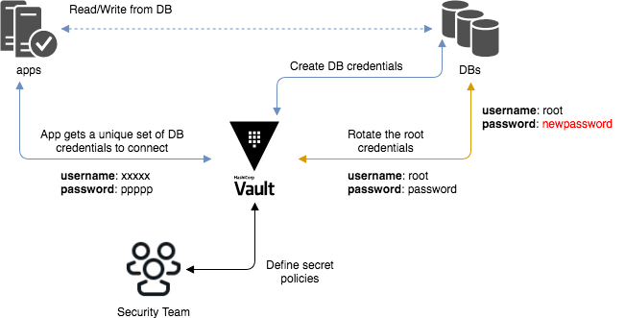
Vault – Database engine
Credential generation and rotation

Slide 17
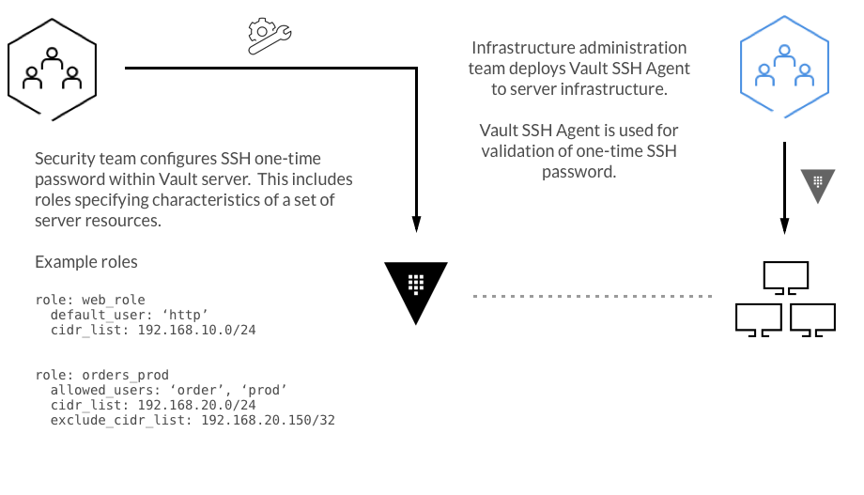
Vault – SSH engine
OTP ( implementation )

Slide 18
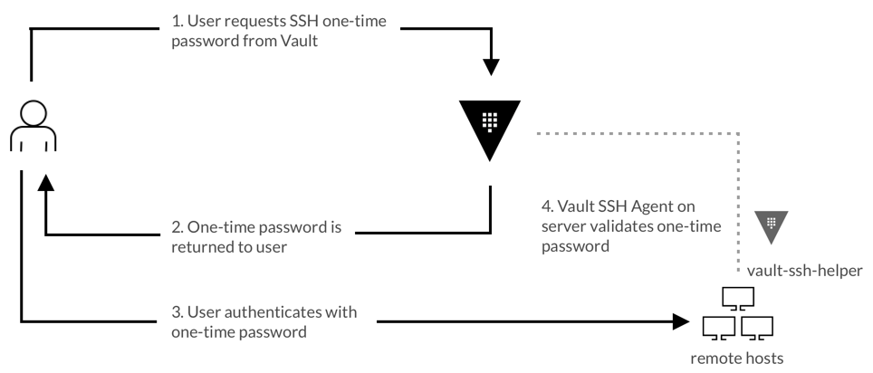
Vault – SSH engine
OTP ( usage scenario )

Slide 19
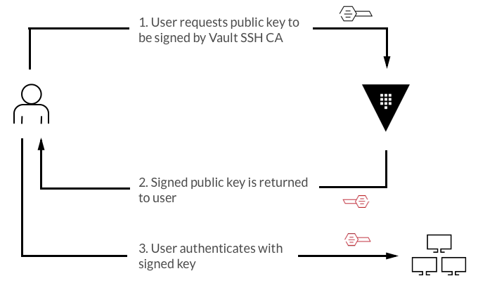
Vault – SSH engine
Public Key Signing

Slide 20
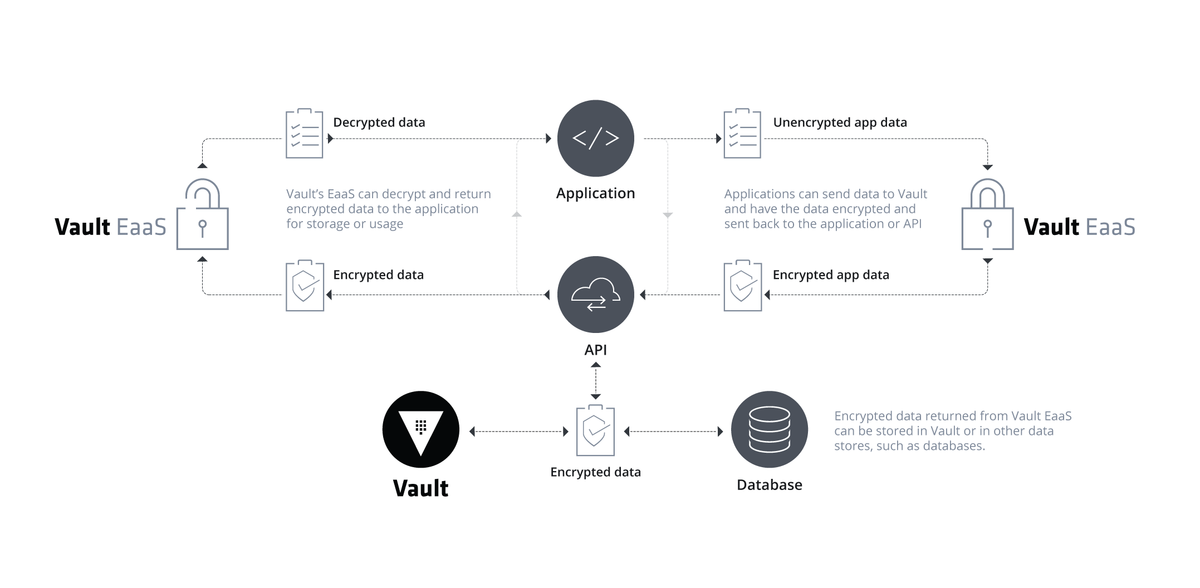
Vault – Transit engine
Encryption as a Service

Slide 21
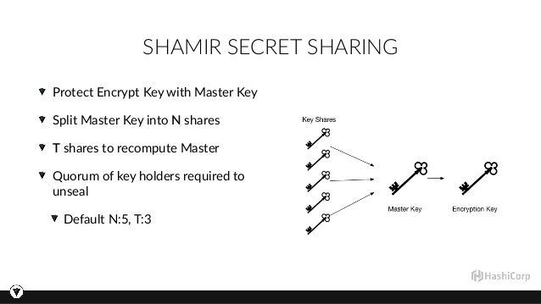
Vault – How the magic happens
Vault Initialization and operation

Slide 22
Demo Time

Slide 23
Vault – Information and tutorials
www.vaultproject.io
learn.hashicorp.com/vault
github.com/carlosrbcunha

Slide 24
Q & A

